Slide 1
Lecture 2: Basic C++ I/O and Expression
Class page: https://github.com/tsung-wei-huang/cs1410-40
Dr. Tsung-Wei Huang
Department of Electrical and Computer Engineering
University of Utah, Salt Lake City, UT
Notes:
Morning everyone
Today we are going to look at some basic C++ input and output and expression.

Slide 2
Announcement
Lab – virtual or physical?
Notes:
Before we start the class, I need to do a quick survey. Some students email me:

Slide 3
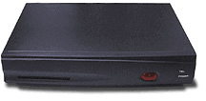
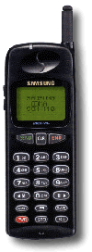
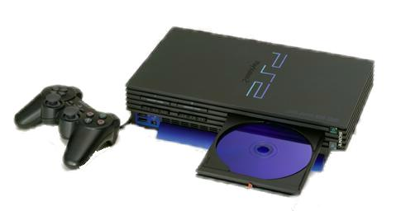

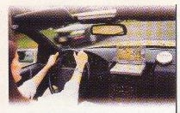
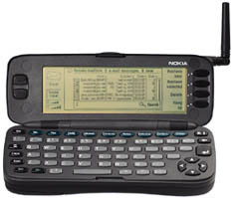
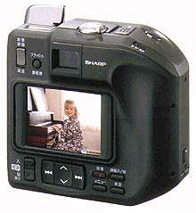
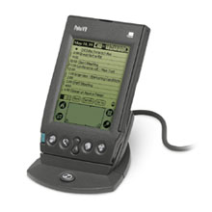
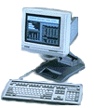
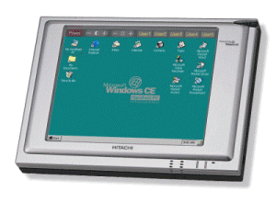
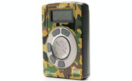
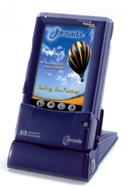
Our World is Driven by Computing
Transmission and Interface
AI
Audio and Video
Connecting
Consumer
Screen Phone
Handheld Game
Mobile Phone
Set Top Box
Game Console
Net TV
Auto PC
Smart Mobile Phone
DSC
Handheld PC
PDA
Thin Client
MP3
Computing
Palm PC
Data Processing
Notes:
Last time, we talked about we are living in a highly connected world. The internet has become the knowledge hub for almost everyone in the world to get connected to each other and the newest trends. We use the internet to do almost all kinds of jobs. And a critical component to support this success is the computing. We want to compute data. we want to extract some useful information out of the data.

Slide 4
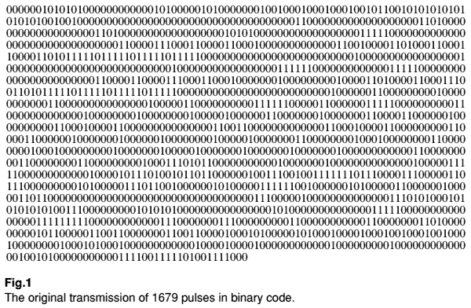
Computing Plays a Key Role
Number
Text
Compute data
Image
Audio
Video
Computer see everything in binary (0 and 1)
Notes:
Data can be numbers (like you phone number), or plain text, images (which are the most commonly used data), audio and video (like youtube). Whichever data you have, we need to compute the data to extract some useful information. We cannot do this by hand, because today's data is so huge and so enormous that we cannot rely on human to do all these things for us. We need to rely on computers because they can compute data much faster than human.
This is indeed very challenging. In the world of computers, everything is digitized. everything is just zero or one. That is what computers see everything in his world. Of course, we must avoid this non-human readable information because no one will be able to interpret zero and one.

Slide 5
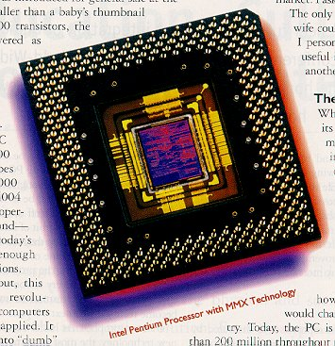
Hardware vs Software
The focus
of this course
main ()
{
say hello;
go to internet;
goodbye;
}
Software
Hardware
Notes:
During the computation, there are two phases, one software and another one hardware. Software is the major layer for people to talk to computer. HArdware is the layer for computer to actually work on your program and run it on computing resources.
By the term you can probably guess, software is more flexible because when you get something wrong, you can just rewrite it, wipe it out and restart everything again.
However, it's a different story on the hardware. When you have a malfunction in hardware, it's million dollars. And the manufacturing process in today's hardware devices are so complicated that you won't afford to have too many errors. This is the fundamental difference between software and hardware.

Slide 6
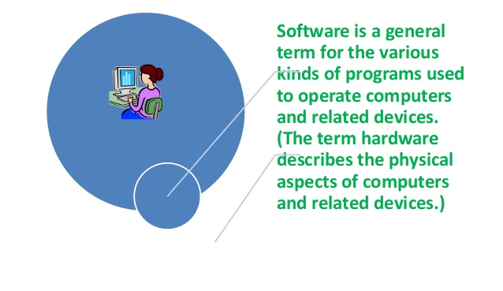
What is Software?
Notes:
What is software? ...

Slide 7
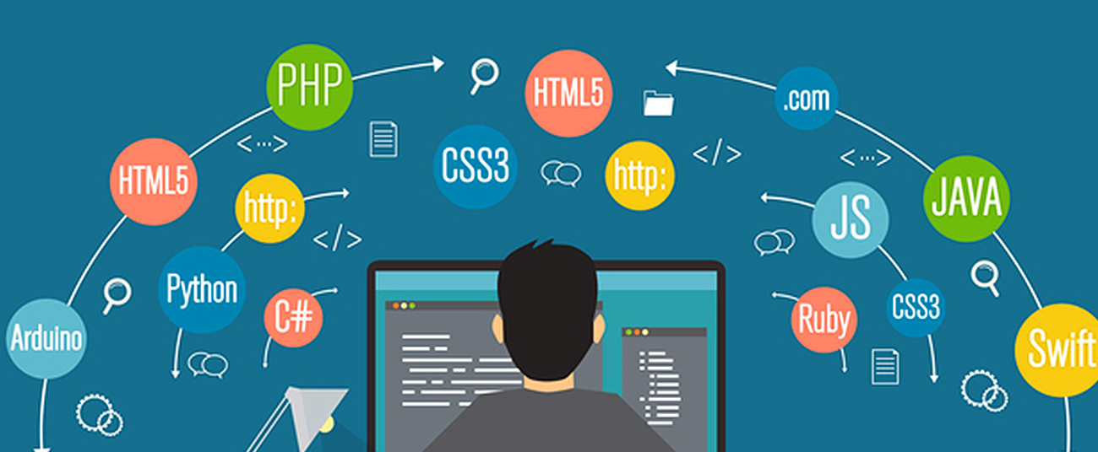
How do We Talk to Computers?
Like we talk to human through “language”
English, Mandarin, Hindi, … => depending on countries
C++, PHP, Python, JS, … => depending on applications
Notes:
In order to operate computers, we must first talk to them. But how do we talk to computers?
Like we talk to human, we use language. We talk to people from different countries using different languages, English, Mandarin, Hindi, and so on, it all depends on countries. For example, if the person comes from the US or the UK, we talk in English. If the person comes from China, we talk in Mandarin.
In computer programming, this "country aspect" translates to "applications". Depending on applications, we have different programming languages, such as C++, Php, python, and javascript. For instance, if you are doing data science, you need quick turnaround time and Python is the best choice. If you are doing computer engineering or electrical engineering, C or C++ is the right language. So, it really depends on the application you target. And the application is driven by the marekt.

Slide 8
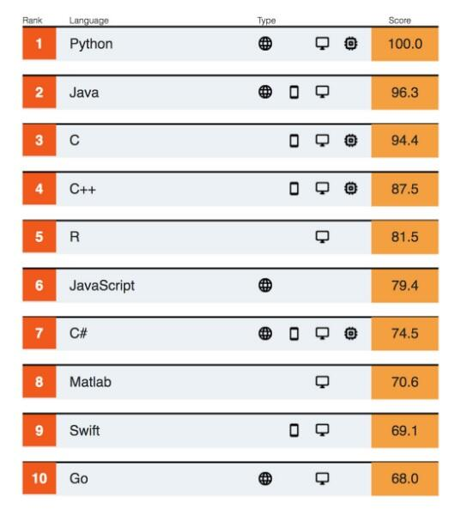
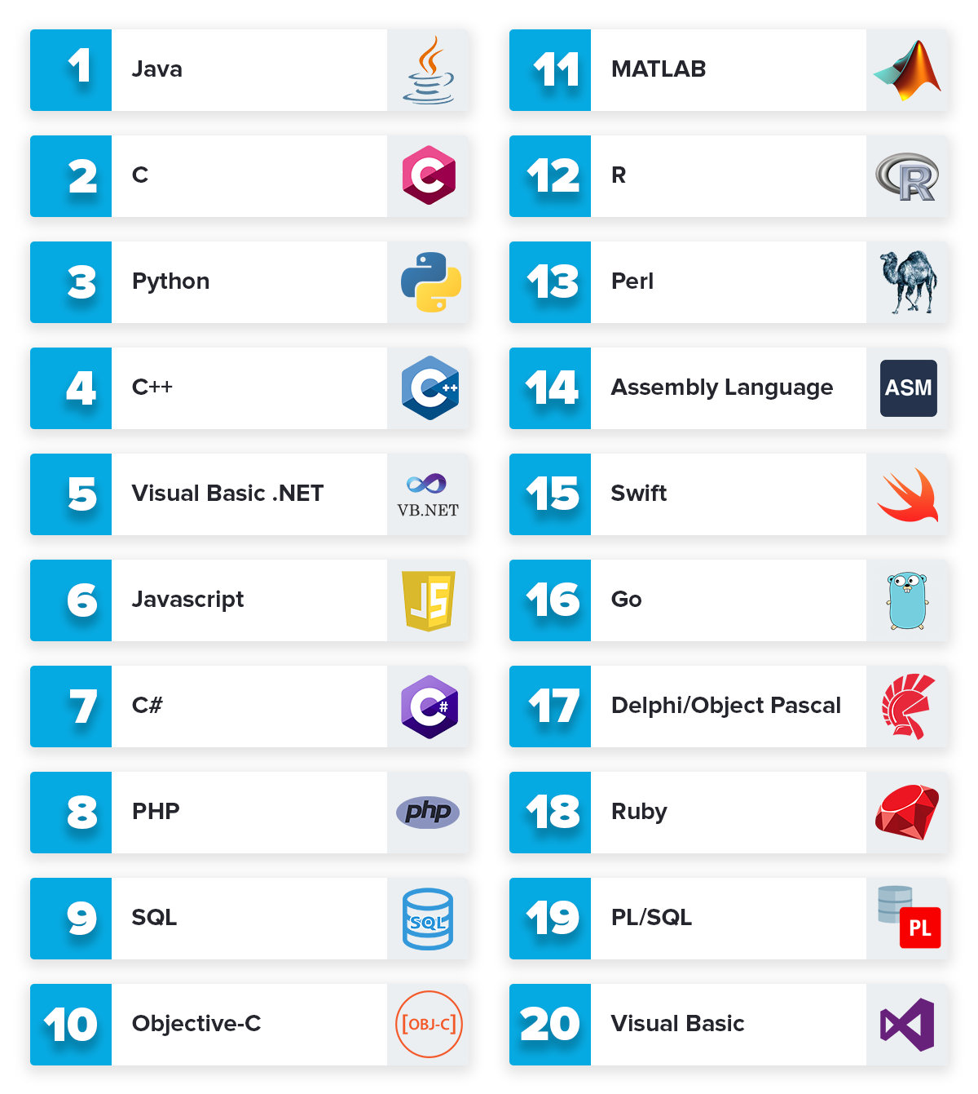
Top 10 Programming Languages
Notes:
This slides shows the top 10 programming languages from multiple resources in 2019. Different tech reports have different results and some of the reports favor their preferred languages. But you can clearly see some of the languages appear in all reports, such as Java, Python, C, and C++, because they are just too important to be ignored. Languages like Java, Python, and C++ dominate the entire software industry.

Slide 9
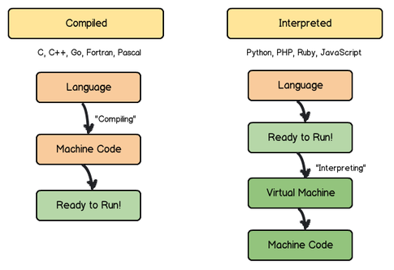
Two Types of Programming Languages
Compiled language vs Interpreted language
Notes:
Roughly speaking, there are two types of programming languages: compiled language and interpreted language. The key difference is:
- the program written in compiled language cannot run directly (...
- the program written in interpreted language can run directly (...

Slide 10
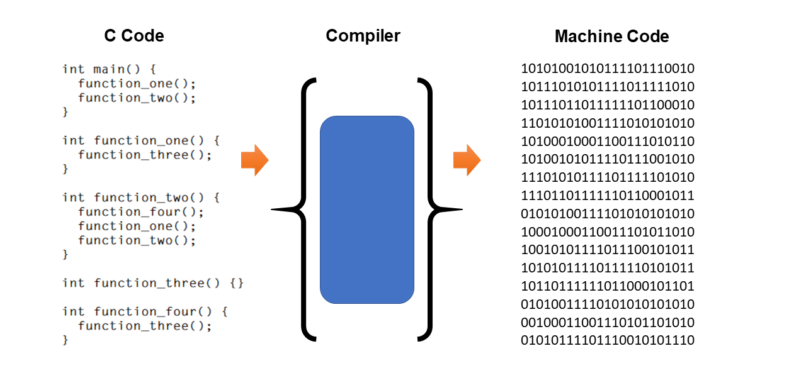
Compilation (e.g., C/C++)
Compile your “entire” code to an executable
Notes:
Let's look at an example of compilation using C programming language. On the left-hand side we have a source code written in C (you don't need to understand its syntax but just recognize it is a C program). In order to run the code, you need to have a compiler first, and invoke the compiler to compile the source code into machine-readable code. Machine-readable code is also called "assembly". Basically, they are just a bunch of zero and ones. These machine code are highly optimized based on your platform. You know, different platforms have different assembly architectures, such as Windows book, MACbook, Google chrome book, and the compiler can generate the machine code optimized for that platform.
So, a key take-away here is, compiled language can give you the best performance because the program you generated is highly optimized on a particular platform.

Slide 11

Compilation can be Very Long
May take HOURS to compile a large codebase …
Do you know how long it takes to compile Google code?
Notes:
The major downside of compiled language is compilation can be very long. It may take hours to compile a large codebase ...
In a company I work before, if we want to find someone for coffee, we don't say "let's go for coffee" but "hey, get your code compiled". It's funny because it is really long, and everytime I change something I need to get it compiled first, before I can run it to test my results. This is the biggest problem of compiled language.

Slide 12
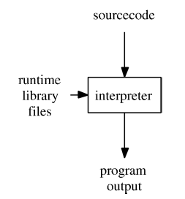
Interpretation
Run your code line by line
Notes:
Different from compilation, interpretation runs your code line by line. It doesn't need to see the entire code at once like compiled language but can run it line by line. This means, if there are syntax errors, like you write something wrong, the interpreter will not encounter that errors until it executes that line of code. So you have a much faster turnaround time to test your code during the development phase.

Slide 13
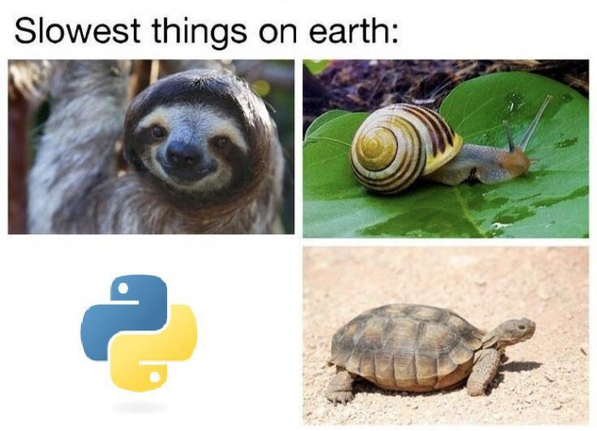
Interpretation can be Very Slow
Python
Notes:
You probably can guess, interpretation can be very slow - because it runs everything line-by-line without compilation that optimizes the control flow and code. Many people are joking with Python which is a very famous interpreted language, the speed is like turtle.

Slide 14
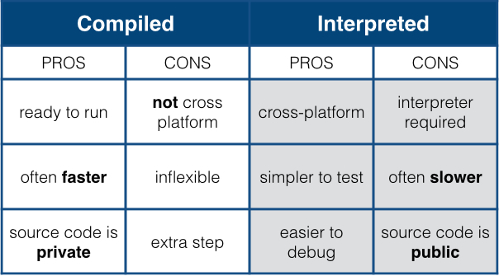
Pros and Cons
Again, real cost depends on applications
Notes:
This table summarizes the pros and cons between compiled language and interpreted language.

Slide 15
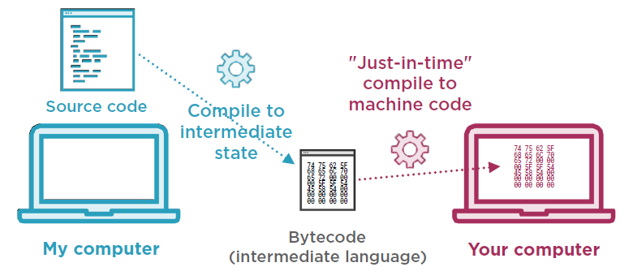
Just-in-time Compilation
A mix of both (e.g., JavaScript)
Notes:
In fact, there is a recent technology becoming more and more popular called Just-in-time compilation or JIT for short. Just in time compilation essentially combines the advantages of compiled language and interpreted language. What it does is, it starts with interpretation, and keeps running the code. While running the code, it does some analysis on the code and may invoke a native compiler to generate assembly to optimize some performance critical blocks. So you can see this type of technology is very useful for applications that have regular or iterative process. (explore...
Of course, Just in time compilation also inherits the downsides of both, so it is used in certian applications and is not replacing interpreter or compiler.

Slide 16
What Types of Language you will use?
I am doing embedded software for autonomous cars
I am working on performance-critical applications
I am building a high-frequency trading platform
I am prototyping my software products
I am building circuit design software
I am creating my own website
Notes:
Let's stop here for 3 minutes and please take a look at the following scenarios and think about which kind of language you may need to use.

Slide 17

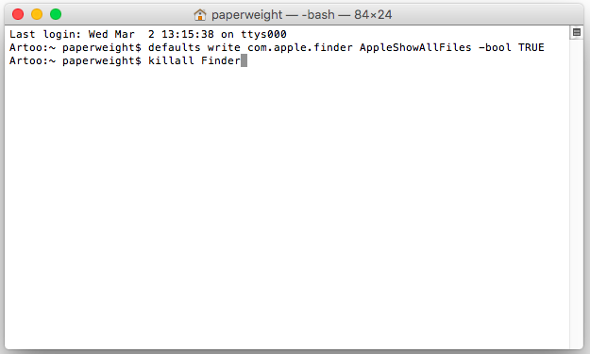
Programming Environment
Terminal
A computer terminal is an electronic or electromechanical hardware device that can be used for entering data into, and displaying or printing data from, a computer or a computing system.
Notes:
Now we know the two types of programming language, what about the programming environment. In this course, we will use "terminal" to write your program. A computer terminal is an ....
Essentially, a terminal is the "most basic" interface for you to operate computer without graphic interface. It is very simple and we will use terminal to wirte programs most of time.

Slide 18
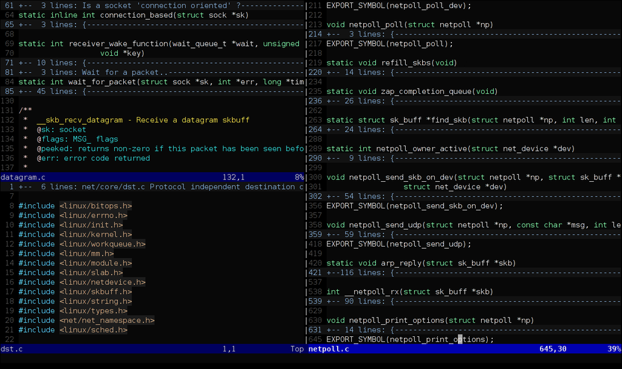
Editor (We will use VIM)
Notes:
Once you open a terminal that connects to a computer, you will need an editor to write programs. An editor is like microsoft word or powerpoint. It lets you type in code and define syntax highligh to colorize different keywords so it makes everything easier to recognize. In this course, we will use "vim" - for many of you who have never used it before, the learning curve may be a bit high, but once you overcome the hurdle, it becomes very easy and general. For now, I am still using vim and I believe most engineers doing C++ programming are using vim today.

Slide 19
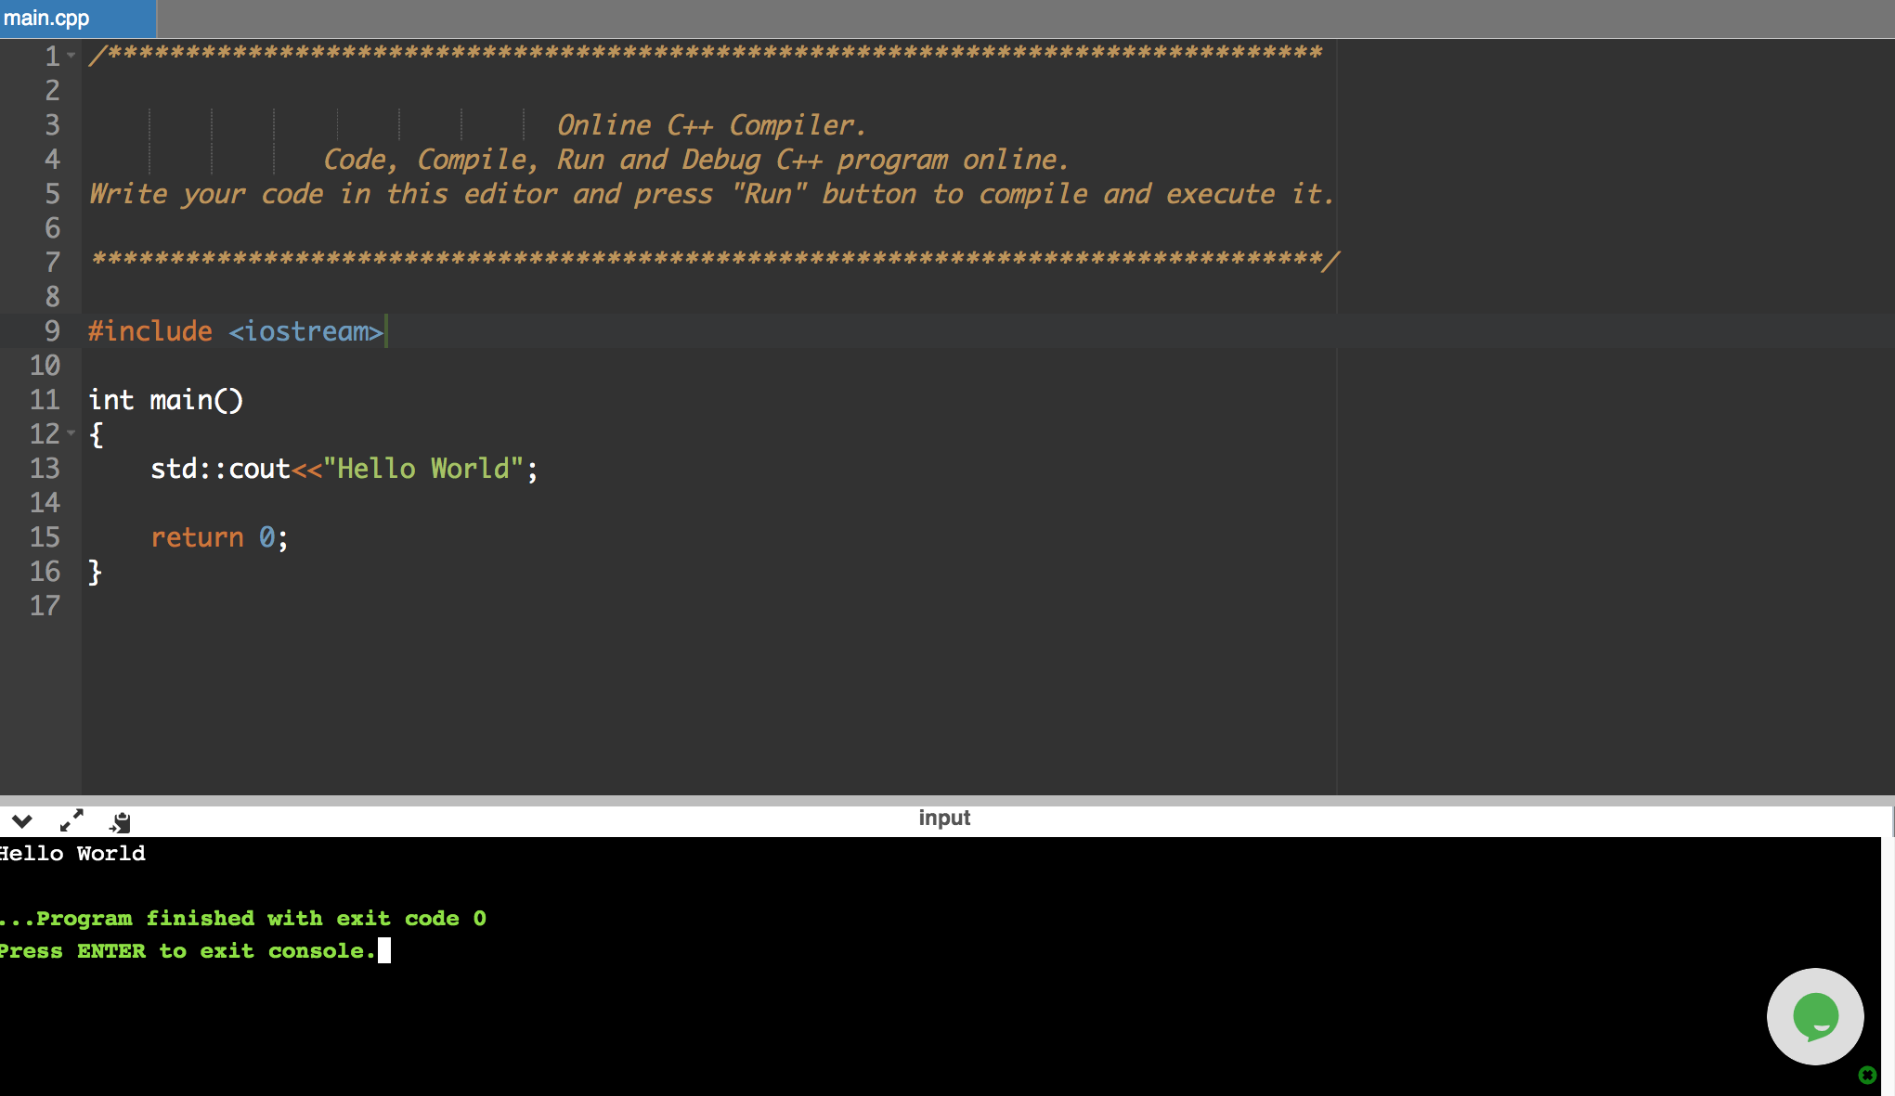
There are also online C++ Editors
https://www.onlinegdb.com/online_c++_compiler
Notes:
There are also online editor that you can use to write C++ code. This is useful when you don't have access to a terminal or a machine but you want to write C++ code and test it in a quick cycle.

Slide 20
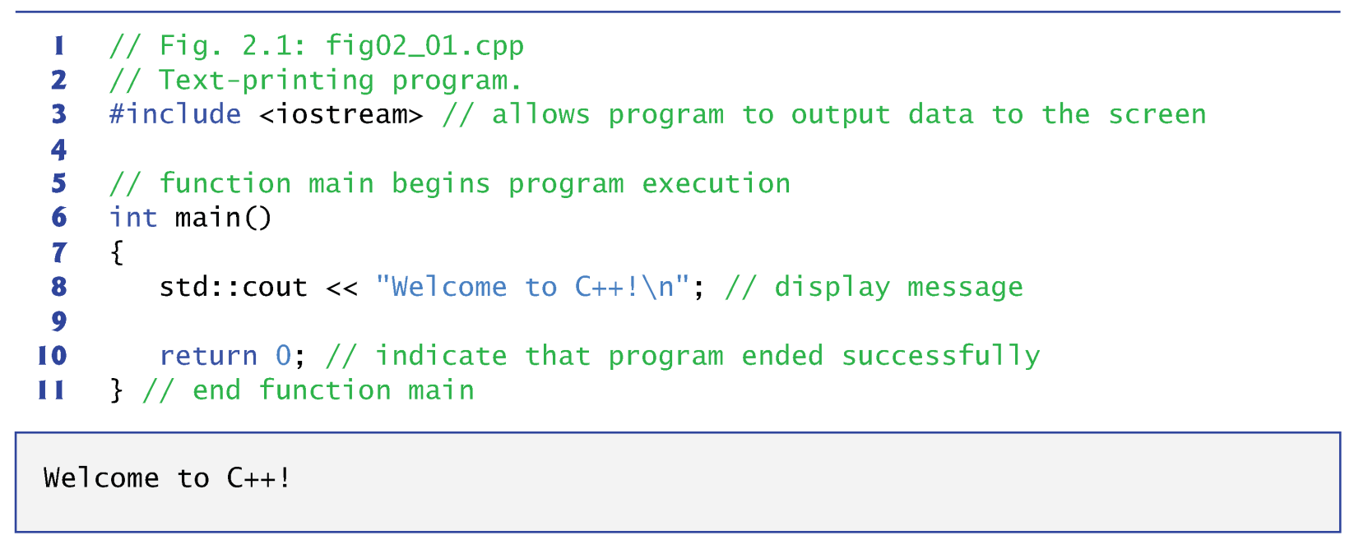
Output - I
Notes:
Any question so far?
Let's look at our first C++ program that prints out a simple hello message. This is a C++ code. The first thing you need to do is to include that allows your program to use functions that are provided by the libraries, instead of writing your own. Including a library is like you go to HomeDepot to buy a driller so you can use the driller to do construction work instead of building a driller on your own which is very difficult.
All the program starts from a main function. This is where the operating system recognizes the entry pooint of your program. When you run your program, the first entry point you enter is the main block.
Inside the main function, we use std::cout to output an message. std::cout is a global object defined by the library for you to output message. The message under the quotation indicates it is a string. A string is a human readable text.
Another important message here is 'std::' represents the namespace. A namespace is where you can define your own things without naming conflict with others. Think about this ...
Finally, we return an integer from main function.

Slide 21
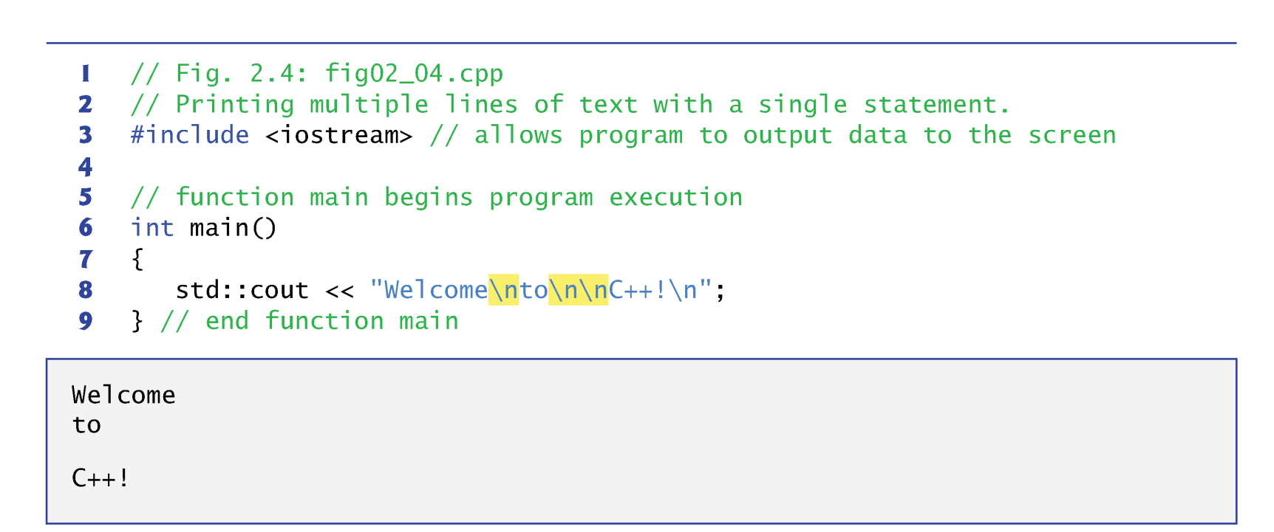
Output - II
A single statement can print multiple lines by using newline characters.
Each time the \n (newline) is encountered, the screen cursor is positioned to the beginning of the next line.
Notes:
For this prining statement using std::cout, a single state ...\

Slide 22
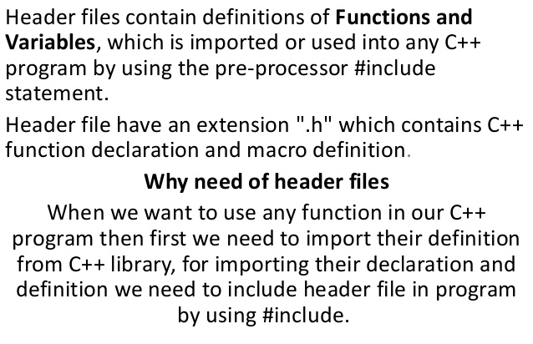
Header files #include <xxx>

Slide 23
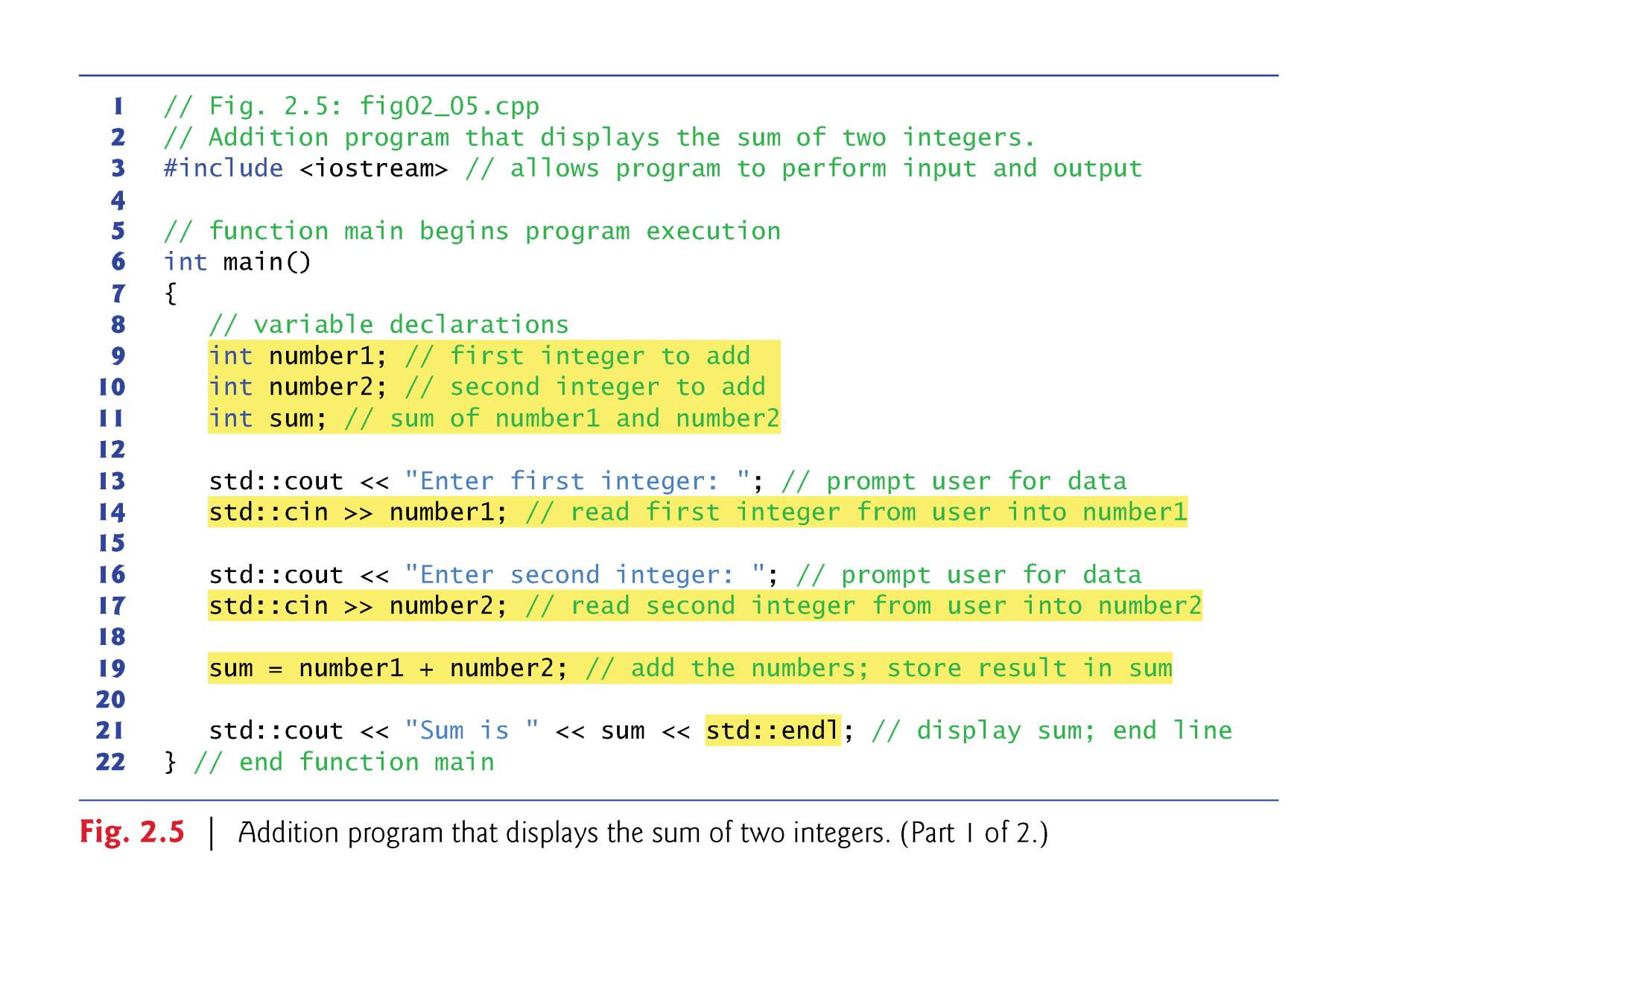
Input - I
The input stream object std::cin and the stream extraction operator, >>, can be used obtain data from the user at the keyboard.
Notes:
Now we understand how to output a message. Another fundamental concept is input. We need to take data from users so we can do some processing on the data. In C++, the input stream ...
(explain number1, number2,...)

Slide 24
Input - II
Declarations introduce the identifiers number1, number2 and sum into programs; they are the names of variables.
A variable is a location in the computer’s memory where a value can be stored for use by a program.
Variables number1, number2 and sum are data of type int, meaning that these variables will hold integer values.
All variables must be declared with a name and a data type before they can be used in a program.
If more than one name is declared in a declaration, the names are separated by commas (,) → called comma-separated list.
int number1,number2;
Notes:
Speaking of input, we must let the program know what data type your input is, right? Remember earlier in the slide I menion there are multiple data types, numbers, texts, binary, and so on. In our example, declaration ...

Slide 25
Input – III (other data types)
Data type double is for specifying real numbers, and data type char for specifying character data.
Real numbers are numbers with decimal points, such as 3.4, 0.0 and –11.19.
A char variable may hold only a single lowercase letter, a single uppercase letter, a single digit or a single special character (e.g., $ or *).
Types such as int, double and char are called fundamental types.
Fundamental-type names are keywords and therefore must appear in all lowercase letters.
Notes:
There are other data types defined by the C++ language. For example, ...

Slide 26
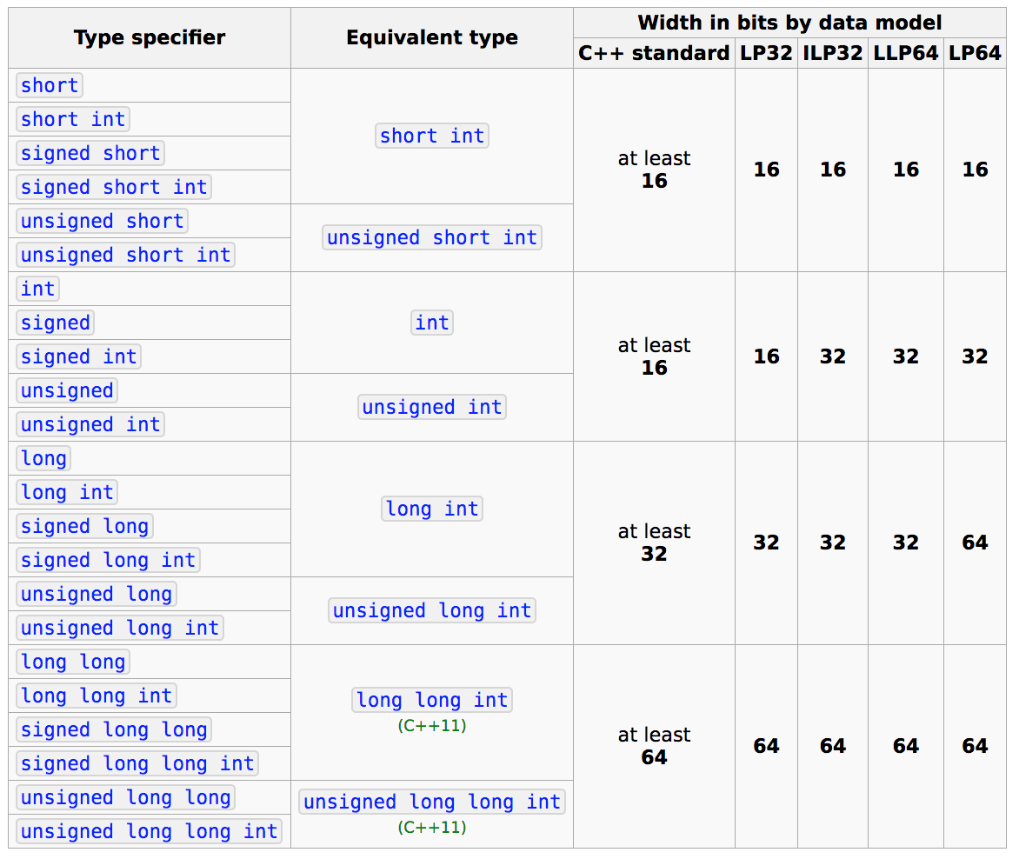
Fundamental Data Types
https://en.cppreference.com/w/cpp/language/types
Notes:
This slides shows all the fundamental data types of C++. Each data type represents a particular number in inters or numerics. Each data type has a fixed width bit, where each bit represents a zero or one in the binary system of computer.
For example, if you define int, it has 32 bit; if you define double, it has 64 bit. The longer the bit width, the larger the value it can represent.

Slide 27
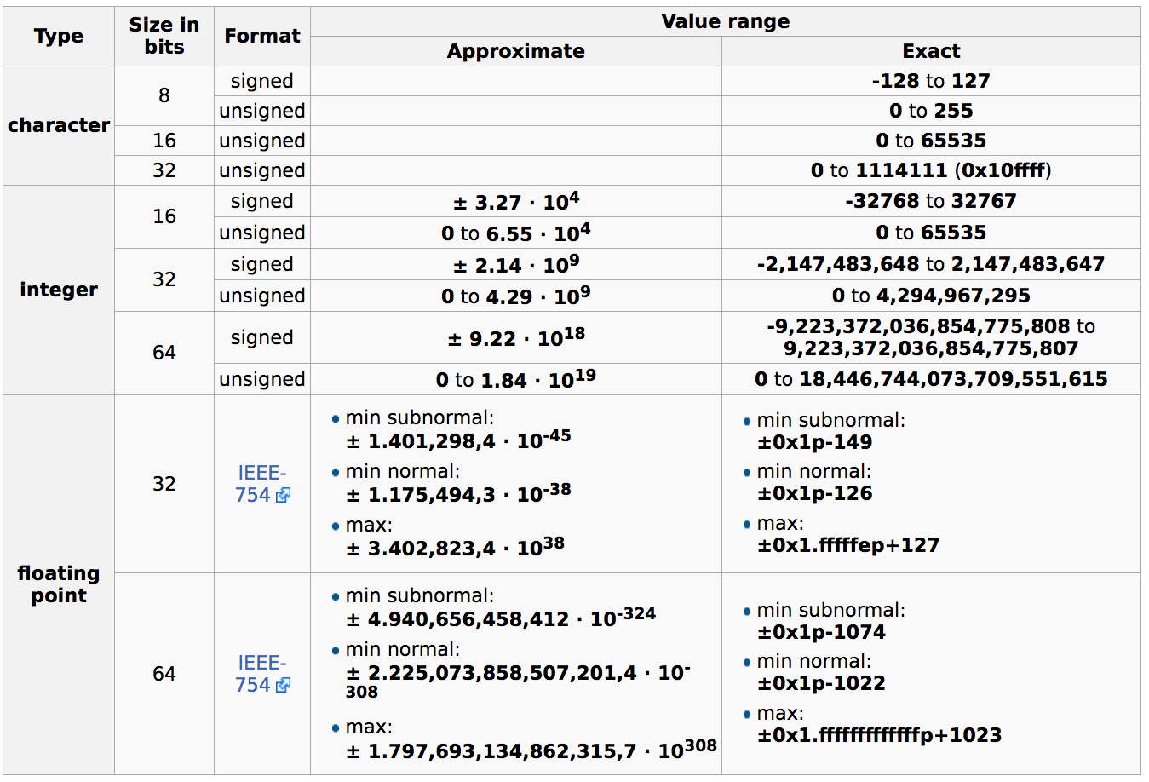
Range of Data Types
Notes:
Here is the slide that summarizes the range of data types.

Slide 28
C++ is a Strongly Typed System
Notes:
A key takeaway - C++ is a strongly typed system. All the variables you create must have a type. Each type has a predefined memory layout that the compiler can leverage to optimize the program.

Slide 29
Declare Variables
Using the fundamental data types
e.g. int my_variable
A variable name is any valid identifier that is not a keyword.
An identifier is a series of characters consisting of letters, digits and underscores ( _ ) that does not begin with a digit.
C++ is case sensitive—uppercase and lowercase letters are different, so a1 and A1 are different identifiers.
Declarations of variables can be placed almost anywhere in a program, but they must appear before their corresponding variables are used in the program.
Notes:
Now we know the data type, we use it to declare variables.

Slide 30
Variable Naming is Important …
Tip 1: C++ allows identifiers of any length, but your C++ implementation may restrict identifier lengths. Use identifiers of 31 characters or fewer to ensure portability
Tip 2: choose meaningful identifiers makes a program self-explanatory—a person can understand the program simply by reading it rather than having to refer to the manuals or comments
int parent, PARENT;
int mom, dad;
Good naming is always fundamental to effective code reviews and collaboration

Slide 31
Adding Integers - I
A prompt directs the user to take a specific action.
A cin statement uses the input stream object cin (of namespace std) and the stream extraction operator, >>, to obtain a value from the keyboard.
Using the stream extraction operator with std::cin takes character input from the standard input stream, which is usually the keyboard.
Notes:
Let's go back to our previous example of input. I have declarated a variable "number1" and now I want to assign it a value from the user. Here I use std::cin, which is a global object defined by the C++ library for your program to digest data from the console. When the program encounters this instruction, a prompt ....

Slide 32
Adding Integers - II
When the computer executes an input statement, it waits for the user to enter a value for variable number1.
The user types the number (as characters) then press the Enter key (or the Return key) to send the characters to the computer.
The computer converts the character representation of the number to an integer and put the value to the variable number1.
Any subsequent references to number1 in this program will use this same value.
Notes:
When the program execution encounter the std::cin instruction, it waits for the user to enter ...

Slide 33
Adding Integers - III
In this program, an assignment statement adds the values of variables number1 and number2 and assigns the result to variable sum using the assignment operator =.
Most calculations are performed in assignment statements.
The = operator and the + operator are called binary operators because each has two operands.
Notes:
In this program ... using the assignment operator '='. Assignment operator is the most fundamental building block to construct an expression. A program consists of multiple expressions to describe your behavior.
Notice that the equal sign "=" has nothing to do with the equation you learn from high school, for example, you may need to solve an equation y equals x square plus 1. That is an equation. In C++ program, this is an assignment. The equal sign is an assignment operator and the + is a binary operator that adds two number and return the result to the left-hand side.

Slide 34
Adding Integers - IV
std::endl is a so-called stream manipulator.
The name endl is an abbreviation for “end line”
std::endl outputs a newline and flushes the output buffer.
Some systems may accumulate outputs in the machine (output buffer) and display them simultaneously on the screen.
std::endl forces any accumulated outputs to be displayed.
Using multiple stream insertion operators (<<) in a single statement is referred to as concatenating, chaining or cascading stream insertion operations.
Calculations can also be performed in output statements.
Notes:
Once we complete this simple addition, we can cout the value of sum. Here I use std::endl to break the line. std::endl is a stream manipulator that outputs a new line and flushes the output stored in std::cout.

Slide 35
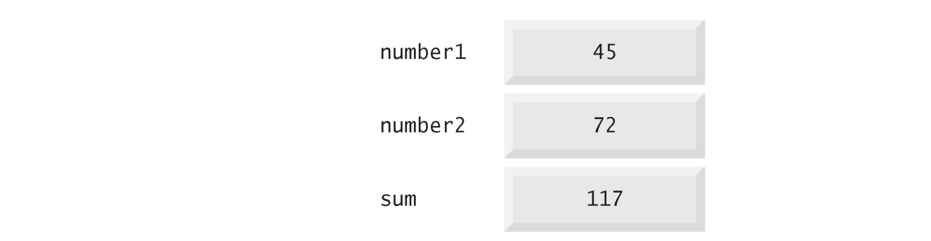
Memory Concepts
Variable names such as number1, number2 and sum actually correspond to locations in the computer’s memory.
Every variable has a name, a type, a size and a value.
When a value is placed in a memory location, it overwrites the previous value in that location → destructive
When a value is read out of a memory location, the process is nondestructive.
Notes:
Now we have seen a basic C++ program that takes two input number1 and number2 from the user, sum the two numbers, and store the result in a variable. It's important for us to know how this program actually works on hardware, or memory. Remember that in the first lecture, we talked about C++ is powerufl in mapping your program directly into hardware. One of the fundamental concepts is memory architecture of your data.
(explain each item ...)

Slide 36
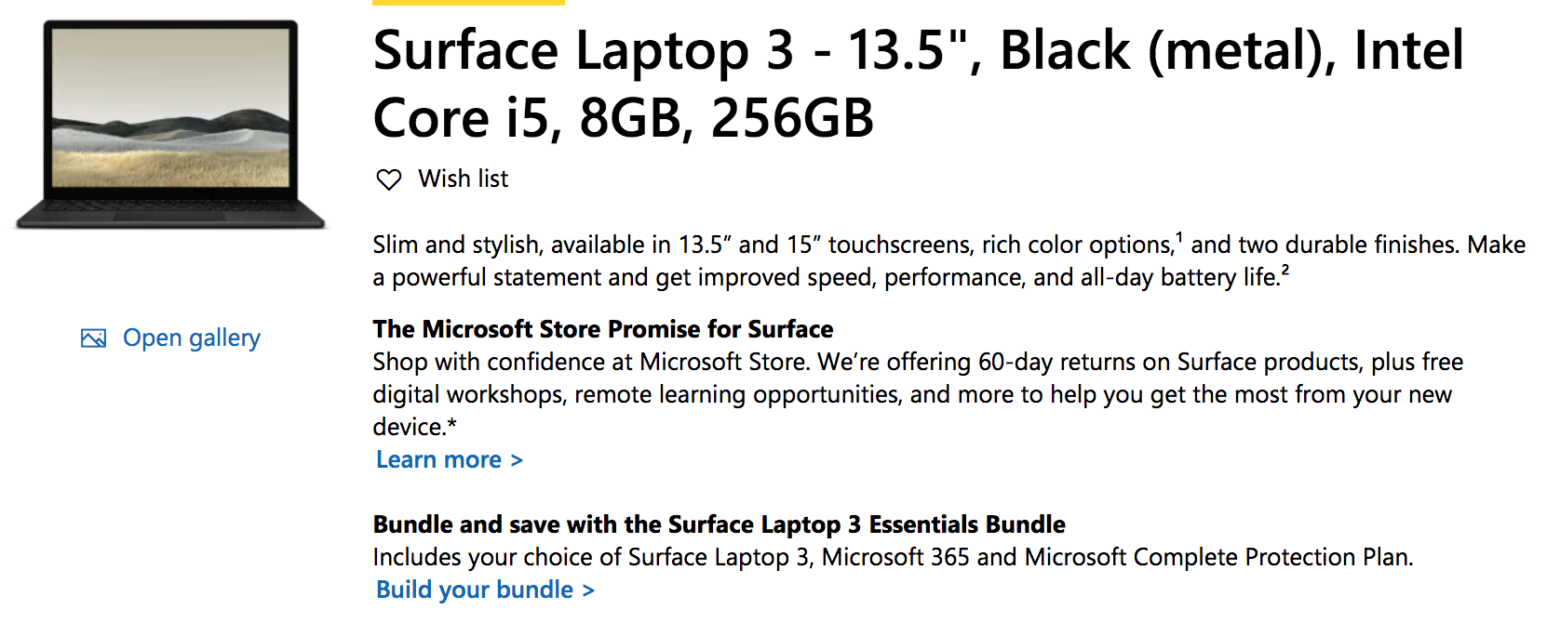
Yes, Memory is Limited
You may not create too many variables
e.g. one trillion integers or more
This literally means your program can run up to 8 GB memory
Notes:
You probably already know, memory is limited. Yes, that means you may not create too many variables, for example, a trillion integers or more. The largest size of the program you can run on your machine depends on the memory size you have. You can get this information when you purchase a laptop or a desktop. For example, below I am showing you a 13 inch surface laptop that has 8GB memory. This literally means your program can run up to 8 GB memory.

Slide 37
Illustration
Memory
std::cout << "Enter first integer: ";
std::cin >> number1;
std::cout << "Enter second integer: ";
std::cin >> number2;
sum = number1 + number2;
std::cout << "Sum is " << sum << std::endl;
sum |  | 0012FF74
 |  | 0012FF75
 |  | 0012FF76
 |  | 0012FF77
number2 |  | 0012FF78
 |  | 0012FF79
 |  | 0012FF7A
 |  | 0012FF7B
number1 |  | 0012FF7C
 |  | 0012FF7D
 |  | 0012FF7E
 |  | 0012FF7F
Output
Notes:
To give you a better idea about how this simple program works on hardware, let's illustrate the runtime. Here I have the program that takes two inputs and sums their values to an output. On the right-hand side, I have the memory with variable name on the left and their virtual address from byte to byte on the right side. Remember each integer is indeed a 32-bit data, that is 4 bytes, because each byte has 8 bits.
Let's run the program.

Slide 38
Illustration
std::cout << "Enter first integer: ";
std::cin >> number1;
std::cout << "Enter second integer: ";
std::cin >> number2;
sum = number1 + number2;
std::cout << "Sum is " << sum << std::endl;
Memory
sum |  | 0012FF74
 |  | 0012FF75
 |  | 0012FF76
 |  | 0012FF77
number2 |  | 0012FF78
 |  | 0012FF79
 |  | 0012FF7A
 |  | 0012FF7B
number1 |  | 0012FF7C
 |  | 0012FF7D
 |  | 0012FF7E
 |  | 0012FF7F
Output
Enter first integer: _

Slide 39
Illustration
Memory
std::cout << "Enter first integer: ";
std::cin >> number1;
std::cout << "Enter second integer: ";
std::cin >> number2;
sum = number1 + number2;
std::cout << "Sum is " << sum << std::endl;
sum |  | 0012FF74
 |  | 0012FF75
 |  | 0012FF76
 |  | 0012FF77
number2 |  | 0012FF78
 |  | 0012FF79
 |  | 0012FF7A
 |  | 0012FF7B
number1 |  | 0012FF7C
 |  | 0012FF7D
 |  | 0012FF7E
 |  | 0012FF7F
Output
Enter first integer: 45_

Slide 40
Illustration
std::cout << "Enter first integer: ";
std::cin >> number1;
std::cout << "Enter second integer: ";
std::cin >> number2;
sum = number1 + number2;
std::cout << "Sum is " << sum << std::endl;
Memory
sum |  | 0012FF74
 |  | 0012FF75
 |  | 0012FF76
 |  | 0012FF77
number2 |  | 0012FF78
 |  | 0012FF79
 |  | 0012FF7A
 |  | 0012FF7B
number1 | 45 | 0012FF7C
 |  | 0012FF7D
 |  | 0012FF7E
 |  | 0012FF7F
Output
Enter first integer: 45
_

Slide 41
Illustration
Memory
std::cout << "Enter first integer: ";
std::cin >> number1;
std::cout << "Enter second integer: ";
std::cin >> number2;
sum = number1 + number2;
std::cout << "Sum is " << sum << std::endl;
sum |  | 0012FF74
 |  | 0012FF75
 |  | 0012FF76
 |  | 0012FF77
number2 |  | 0012FF78
 |  | 0012FF79
 |  | 0012FF7A
 |  | 0012FF7B
number1 | 45 | 0012FF7C
 |  | 0012FF7D
 |  | 0012FF7E
 |  | 0012FF7F
Output
Enter first integer: 45
Enter second integer: _

Slide 42
Illustration
Memory
std::cout << "Enter first integer: ";
std::cin >> number1;
std::cout << "Enter second integer: ";
std::cin >> number2;
sum = number1 + number2;
std::cout << "Sum is " << sum << std::endl;
sum |  | 0012FF74
 |  | 0012FF75
 |  | 0012FF76
 |  | 0012FF77
number2 |  | 0012FF78
 |  | 0012FF79
 |  | 0012FF7A
 |  | 0012FF7B
number1 | 45 | 0012FF7C
 |  | 0012FF7D
 |  | 0012FF7E
 |  | 0012FF7F
Output
Enter first integer: 45
Enter second integer: 72_

Slide 43
Illustration
std::cout << "Enter first integer: ";
std::cin >> number1;
std::cout << "Enter second integer: ";
std::cin >> number2;
sum = number1 + number2;
std::cout << "Sum is " << sum << std::endl;
Memory
sum |  | 0012FF74
 |  | 0012FF75
 |  | 0012FF76
 |  | 0012FF77
number2 | 72 | 0012FF78
 |  | 0012FF79
 |  | 0012FF7A
 |  | 0012FF7B
number1 | 45 | 0012FF7C
 |  | 0012FF7D
 |  | 0012FF7E
 |  | 0012FF7F
Output
Enter first integer: 45
Enter second integer: 72
_

Slide 44
Illustration
std::cout << "Enter first integer: ";
std::cin >> number1;
std::cout << "Enter second integer: ";
std::cin >> number2;
sum = number1 + number2;
std::cout << "Sum is " << sum << std::endl;
Memory
sum | 117 | 0012FF74
 |  | 0012FF75
 |  | 0012FF76
 |  | 0012FF77
number2 | 72 | 0012FF78
 |  | 0012FF79
 |  | 0012FF7A
 |  | 0012FF7B
number1 | 45 | 0012FF7C
 |  | 0012FF7D
 |  | 0012FF7E
 |  | 0012FF7F
Output
Enter first integer: 45
Enter second integer: 72
_

Slide 45
Illustration
Memory
std::cout << "Enter first integer: ";
std::cin >> number1;
std::cout << "Enter second integer: ";
std::cin >> number2;
sum = number1 + number2;
std::cout << "Sum is " << sum << std::endl;
sum | 117 | 0012FF74
 |  | 0012FF75
 |  | 0012FF76
 |  | 0012FF77
number2 | 72 | 0012FF78
 |  | 0012FF79
 |  | 0012FF7A
 |  | 0012FF7B
number1 | 45 | 0012FF7C
 |  | 0012FF7D
 |  | 0012FF7E
 |  | 0012FF7F
Output
Enter first integer: 45
Enter second integer: 72
Sum is 117_

Slide 46
Illustration
Memory
std::cout << "Enter first integer: ";
std::cin >> number1;
std::cout << "Enter second integer: ";
std::cin >> number2;
sum = number1 + number2;
std::cout << "Sum is " << sum << std::endl;
sum | 117 | 0012FF74
 |  | 0012FF75
 |  | 0012FF76
 |  | 0012FF77
number2 | 72 | 0012FF78
 |  | 0012FF79
 |  | 0012FF7A
 |  | 0012FF7B
number1 | 45 | 0012FF7C
 |  | 0012FF7D
 |  | 0012FF7E
 |  | 0012FF7F
Output
Enter first integer: 45
Enter second integer: 72
Sum is 117
Press any key to continue_

Slide 47
binary representation | hexadecimal | decimal
00000000 00000000 00000000 00000000 | 00000000 | 0
00000000 00000000 00000000 00000001 | 00000001 | 1
00000000 00000000 00000000 00000010 | 00000002 | 2
00000000 00000000 00000000 00000011 | 00000003 | 3
00000000 00000000 00000000 00000100 | 00000004 | 4
00000000 00000000 00000000 00000101 | 00000005 | 5
00000000 00000000 00000000 00000110 | 00000006 | 6
00000000 00000000 00000000 00000111 | 00000007 | 7
00000000 00000000 00000000 00001000 | 00000008 | 8
00000000 00000000 00000000 00001001 | 00000009 | 9
00000000 00000000 00000000 00001010 | 0000000A | 10
00000000 00000000 00000000 00001011 | 0000000B | 11
00000000 00000000 00000000 00001100 | 0000000C | 12
00000000 00000000 00000000 00001101 | 0000000D | 13
00000000 00000000 00000000 00001110 | 0000000E | 14
00000000 00000000 00000000 00001111 | 0000000F | 15

Slide 48
Value Representation
Binary, Octal, Decimal, Hex
The six letters (in addition to the 10 integers) in hexadecimal represent: 10 (A), 11 (B), 12 (C), 13 (D), 14 (E), and 15 (F), respectively.
Name | Radix | Digits
Binary | 2 | 0,1
Octal | 8 | 0,1,2,3,4,5,6,7
Decimal | 10 | 0,1,2,3,4,5,6,7,8,9
Hexadecimal | 16 | 0,1,2,3,4,5,6,7,8,9,A,B,C,D,E,F

Slide 49
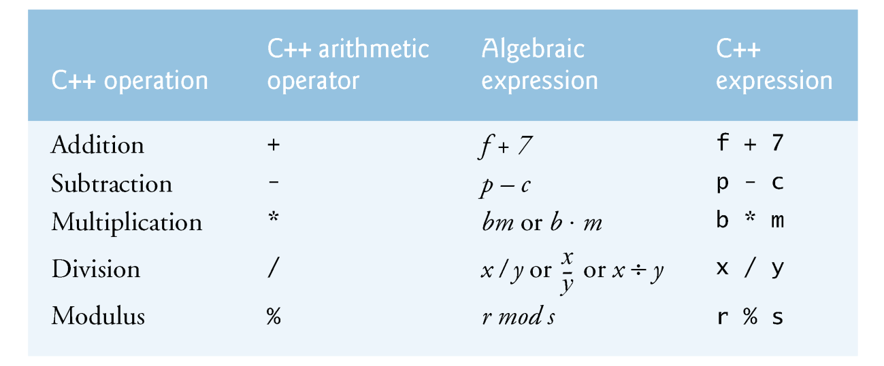
Common Arithmetic Operators
Notes:
We talked about the addition operation. Indeed, there are many more. In C++, we have subtraction that subtracts a number from another, multiplication that multiples a number by another, division that divide a number by another, and modulus operation that finds the remainder of a division, for example, if you divide 7 by 3, the remainder is 1.

Slide 50
Summary
C++ input and output
Variables, data types
C++ is a strongly-typed system
Adding two integers
Value representation (binary, hex, decimal)
Arithmetic operators (+, -, *, /)
Programming Assignment 1 is out!
Email your solution to your section TA (see class page)
Due by class time on 9/2
Notes:
u1306576@umail.utah.edu;u1100840@utah.edu;u1231201@utah.edu;u1059119@utah.edu;u1277271@utah.edu;u1279042@utah.edu;u1288871@utah.edu;u1162987@utah.edu;u1149181@utah.edu;u1034348@utah.edu;u1274730@utah.edu;u1309216@utah.edu;u1307344@utah.edu;u1054050@utah.edu;u0906668@utah.edu;u1020513@utah.edu;u1046844@utah.edu;u0934438@utah.edu;u1028034@utah.edu;u1218276@utah.edu;u1205315@utah.edu;u1235021@utah.edu;u0613876@utah.edu;u1194598@utah.edu;u0800167@utah.edu;u1100383@utah.edu;u1313270@utah.edu;u1170639@utah.edu;u1233102@utah.edu;u0441877@utah.edu;u1306569@utah.edu;u1117469@utah.edu;u1053605@utah.edu;u1186007@utah.edu;u1117512@utah.edu;u1015229@utah.edu;u1322203@utah.edu;u1030352@utah.edu;u1030406@utah.edu;u1298265@utah.edu;u1309248@utah.edu;u1134903@utah.edu;u1080280@utah.edu;u1184264@utah.edu;u1255151@utah.edu;u0726957@utah.edu;u1174177@utah.edu;u1165266@utah.edu;u1201859@utah.edu;u1169721@utah.edu;u1337151@utah.edu;u1025911@utah.edu;u1307883@utah.edu;

